Slide 1

Financial Forcasting Dashboard Using Power Bi
A Presentation By:
SAIKISHORE

Slide 2

Introduction to Financial Forecasting
Financial forecasting is the process of estimating future financial outcomes based on historical data.
Accurate forecasting helps organizations strategize and allocate resources efficiently.
Businesses can leverage tools like Power BI to visualize and interpret forecasting data effectively.
Notes:
Image source: https://www.slidemake.com

Slide 3
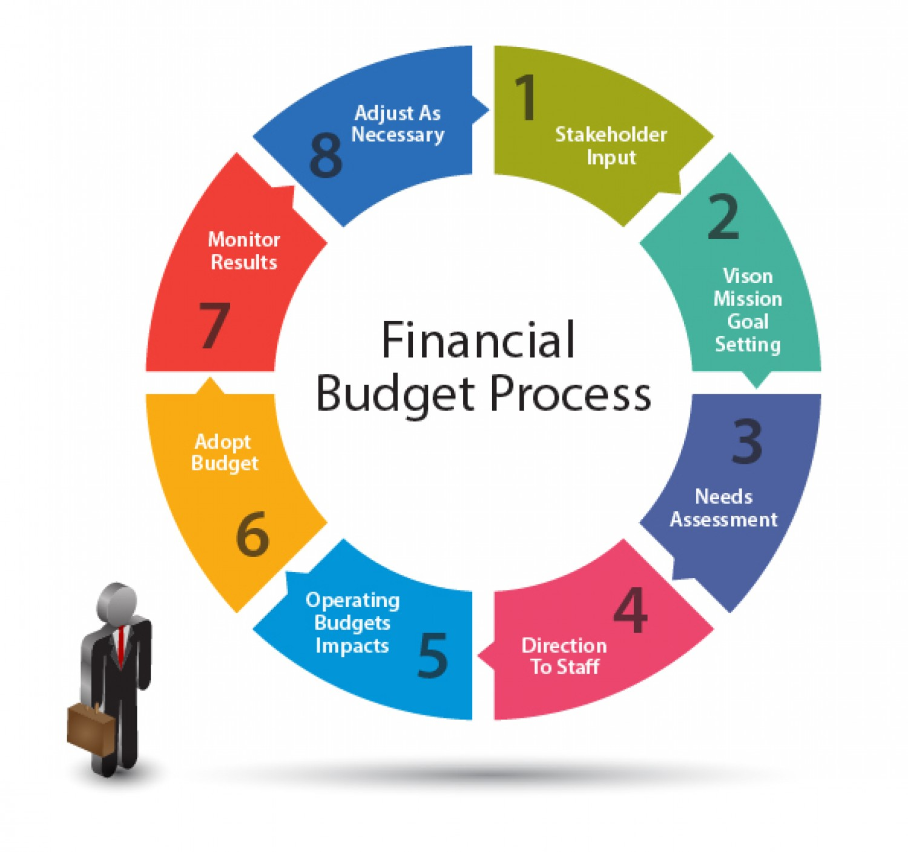
Importance of Financial Forecasting
Financial forecasting aids in budgeting and financial planning for organizations.
It helps in identifying trends that can influence financial performance over time.
Stakeholders can make informed decisions based on reliable forecasting data.
Notes:
Image source: https://churchinfluence.com

Slide 4
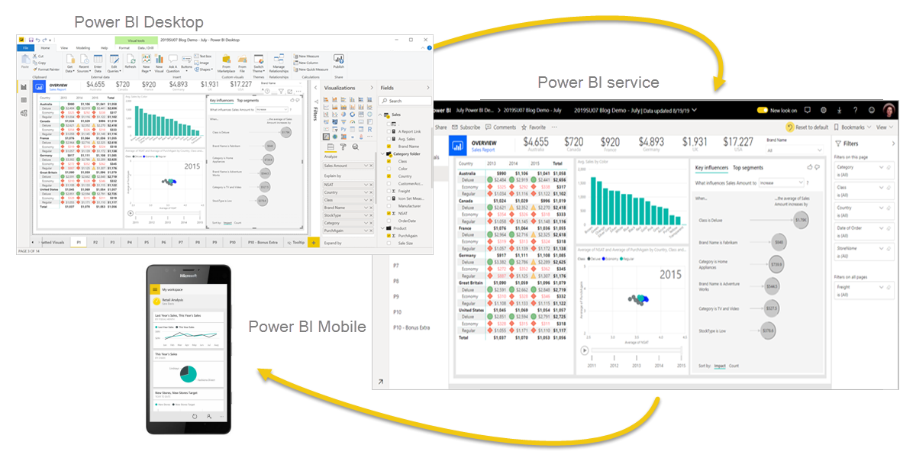
Overview of Power BI
Power BI is a business analytics tool that simplifies data visualization and sharing insights.
It allows users to connect to various data sources and create interactive dashboards.
The platform supports real-time data analysis, enhancing decision-making processes.
Notes:
Image source: https://learn.microsoft.com

Slide 5
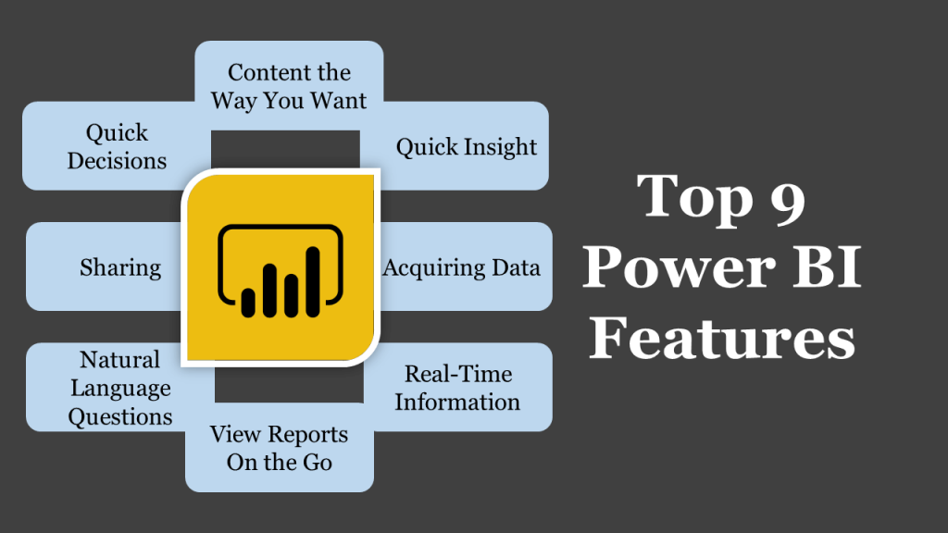
Features of Power BI for Financial Forecasting
Power BI provides advanced analytics capabilities for trend analysis and forecasting.
The tool supports custom visuals that can represent financial data intuitively.
Integration with Excel allows users to utilize existing financial models within Power BI.
Notes:
Image source: https://yodalearning.com

Slide 6
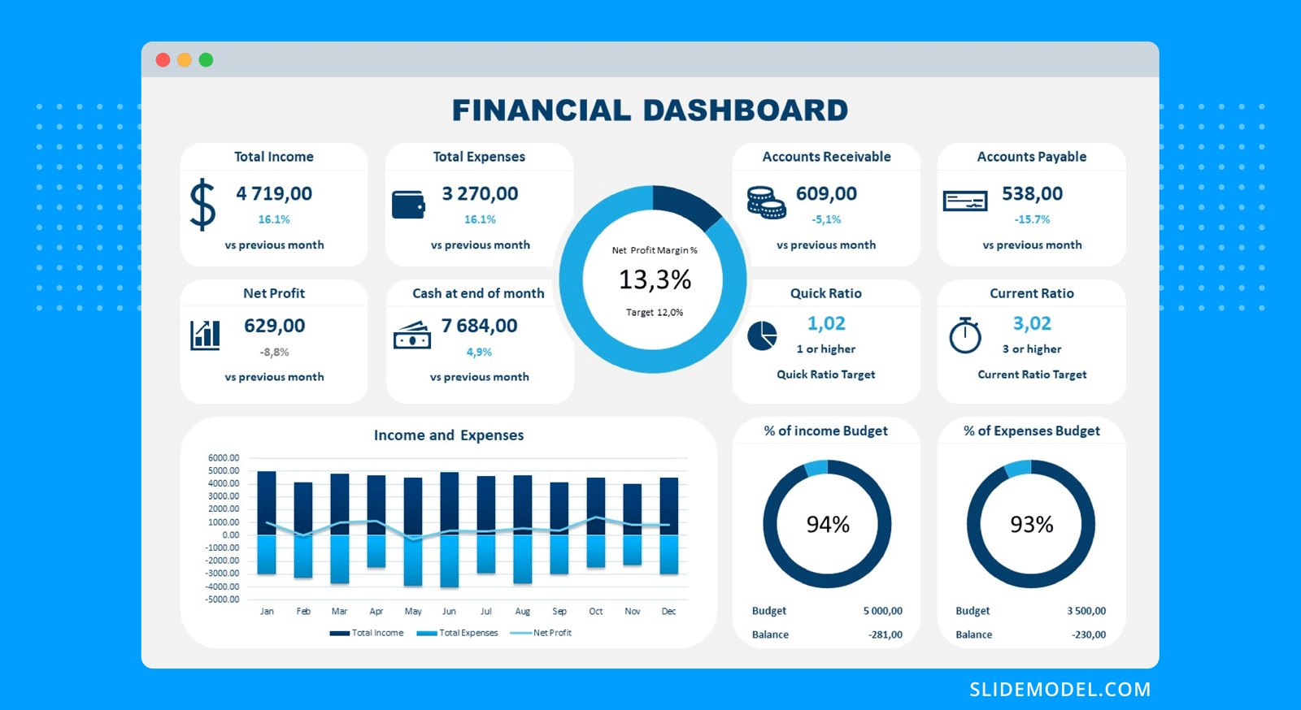
Components of a Financial Dashboard
A comprehensive financial dashboard includes key metrics such as revenue, expenses, and net income.
Visual elements like bar charts, pie charts, and line graphs effectively convey financial data.
The dashboard should allow for real-time updates to ensure data accuracy.
Notes:
Image source: https://slidemodel.com

Slide 7
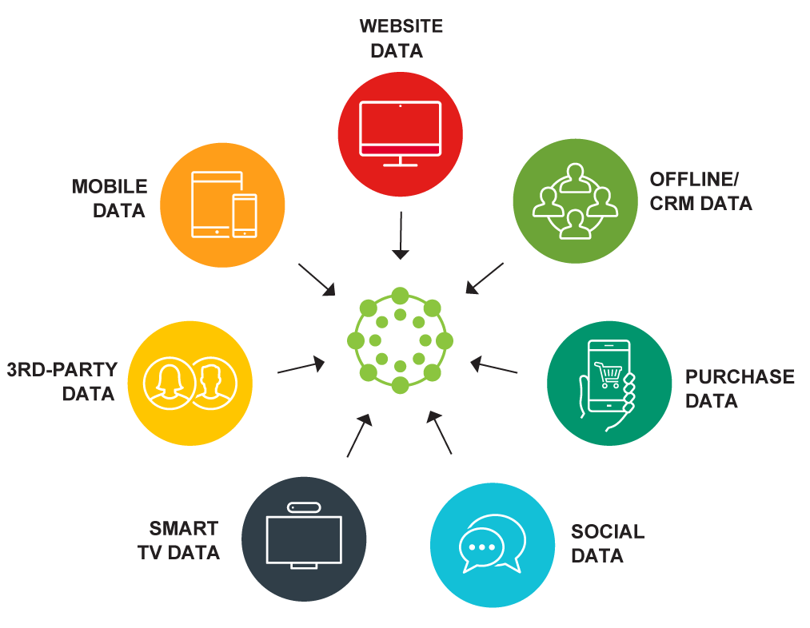
Data Sources for Financial Forecasting
Common data sources include accounting software, ERP systems, and CRM platforms.
Power BI can connect to cloud-based and on-premises data sources for seamless integration.
Ensuring data quality is essential for reliable forecasting results.
Notes:
Image source: https://nrootlabs.com

Slide 8
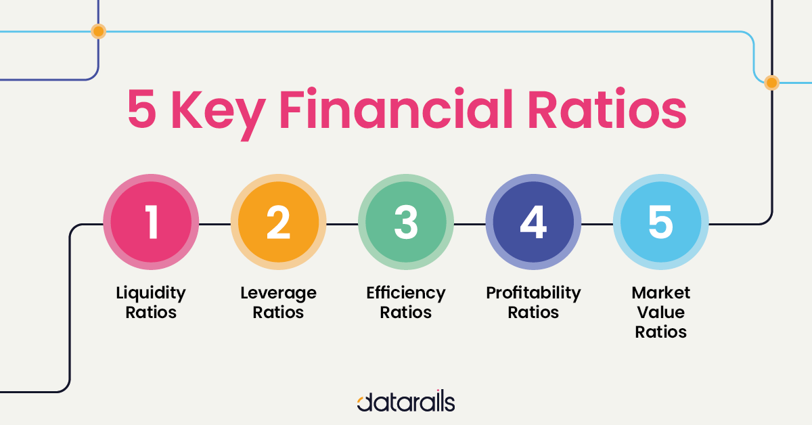
Key Metrics in Financial Forecasting
Revenue growth rate indicates how quickly the company is generating income.
Expense ratios help in understanding the efficiency of operations relative to income.
Profit margins provide insights into the overall profitability of the business.
Notes:
Image source: https://www.datarails.com

Slide 9
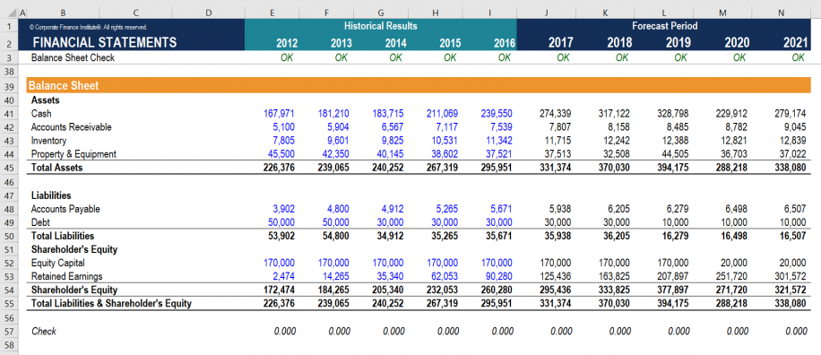
Building the Forecast Model
Start by gathering historical financial data to establish a baseline for forecasting.
Utilize statistical methods such as regression analysis to predict future trends.
Incorporate market conditions and economic indicators to refine the forecast.
Notes:
Image source: https://blog.golayer.io

Slide 10
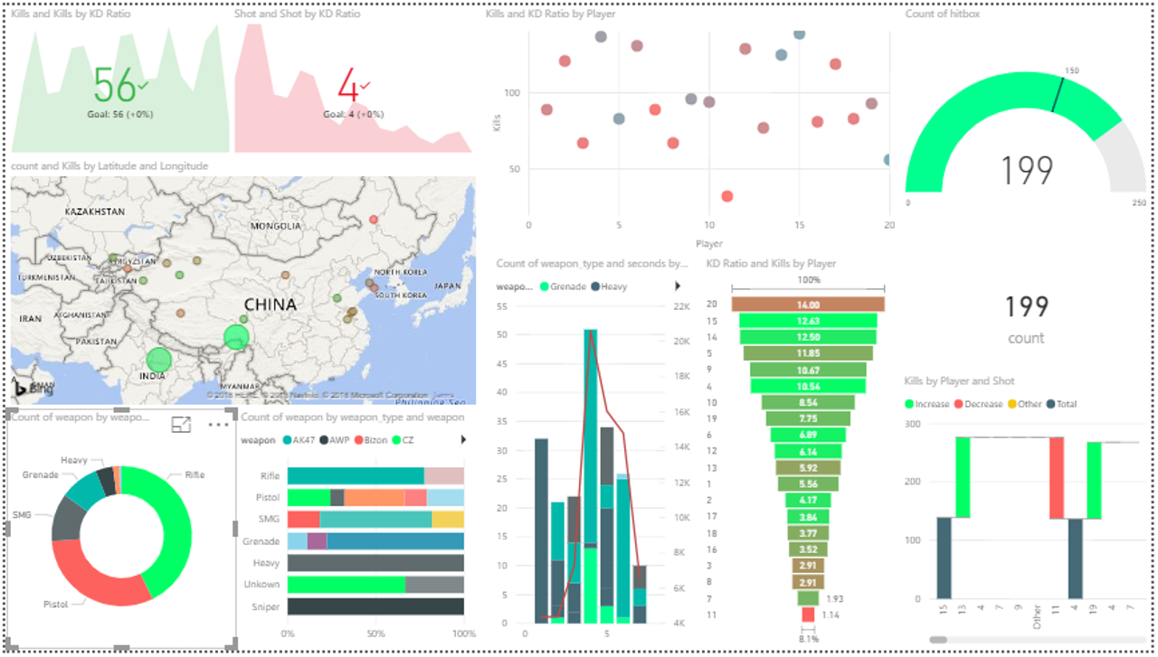
Creating Visualizations in Power BI
Use line graphs to depict revenue trends over time for clarity.
Bar charts can effectively show expense breakdowns across different categories.
Heat maps can provide insights into sales performance by region or product line.
Notes:
Image source: https://www.edureka.co

Slide 11

Implementing Predictive Analytics
Power BI allows for the application of machine learning models to enhance forecasting accuracy.
Predictive analytics can identify potential future scenarios based on historical patterns.
Users can visualize predictive outcomes to better understand their implications.
Notes:
Image source: https://prensariotila.com

Slide 12
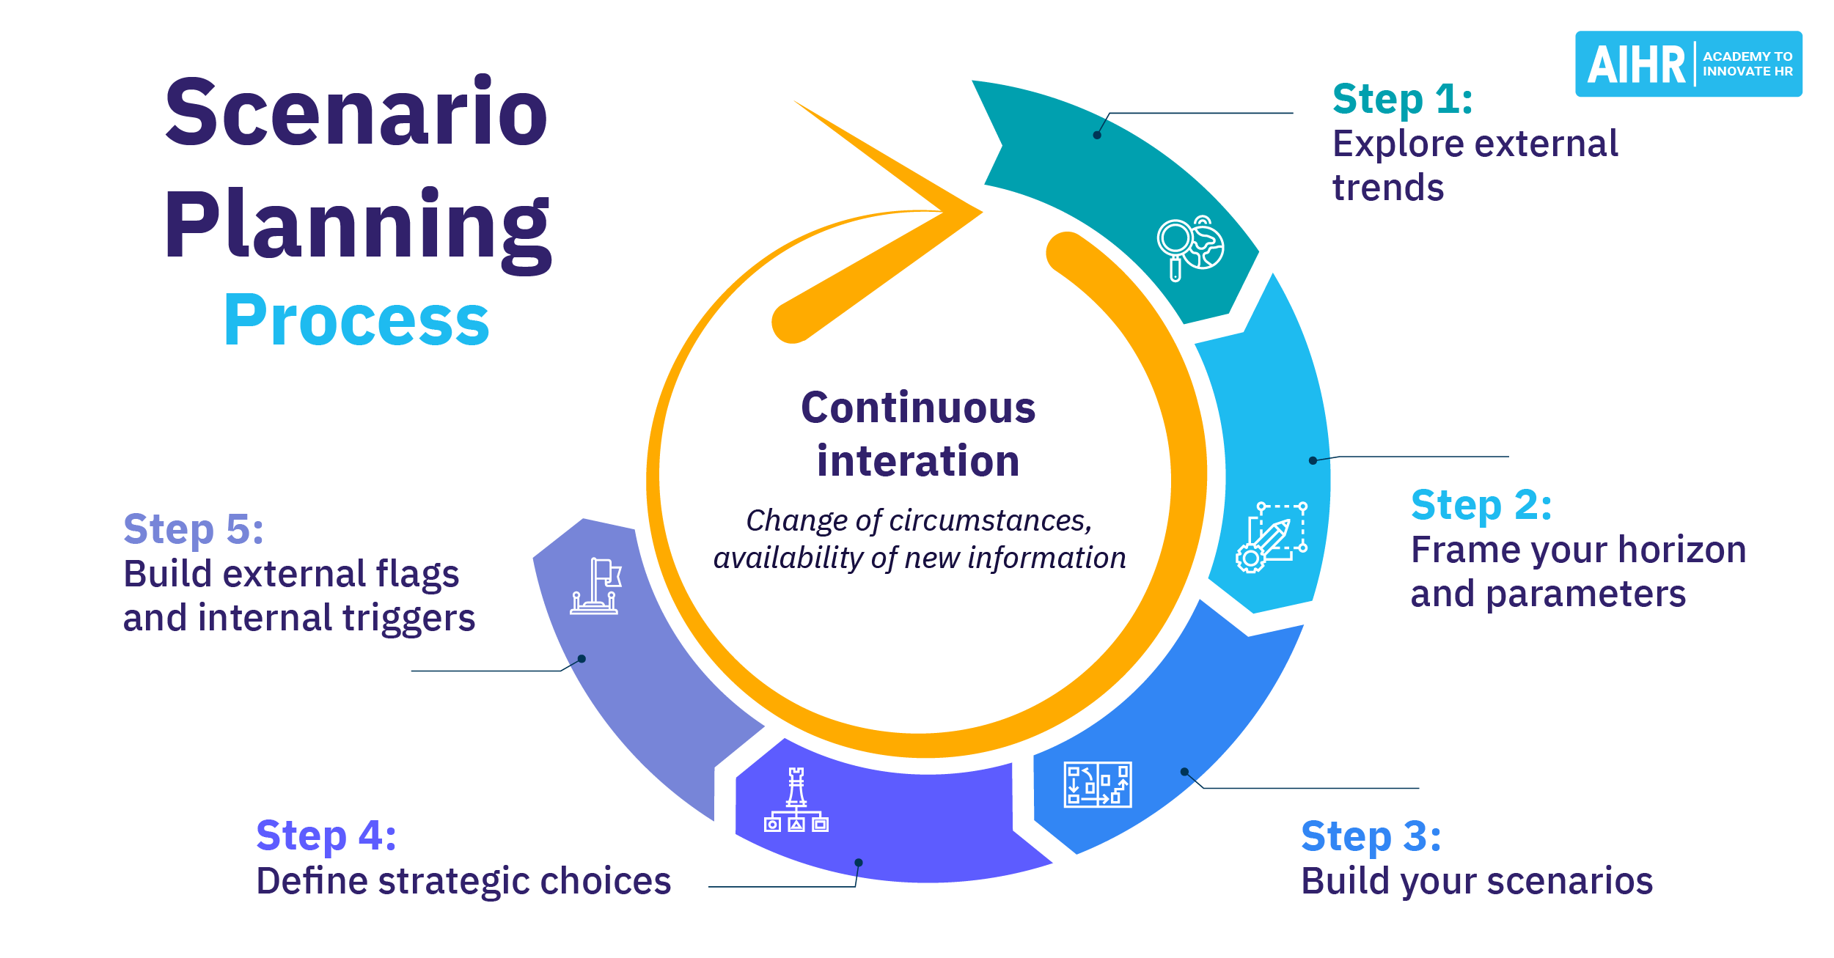
Scenario Analysis and What-If Modeling
Scenario analysis helps in examining the impact of different financial assumptions.
Power BI enables users to create dynamic what-if models for informed decision-making.
This analysis can guide strategic planning and risk management efforts.
Notes:
Image source: https://www.aihr.com

Slide 13
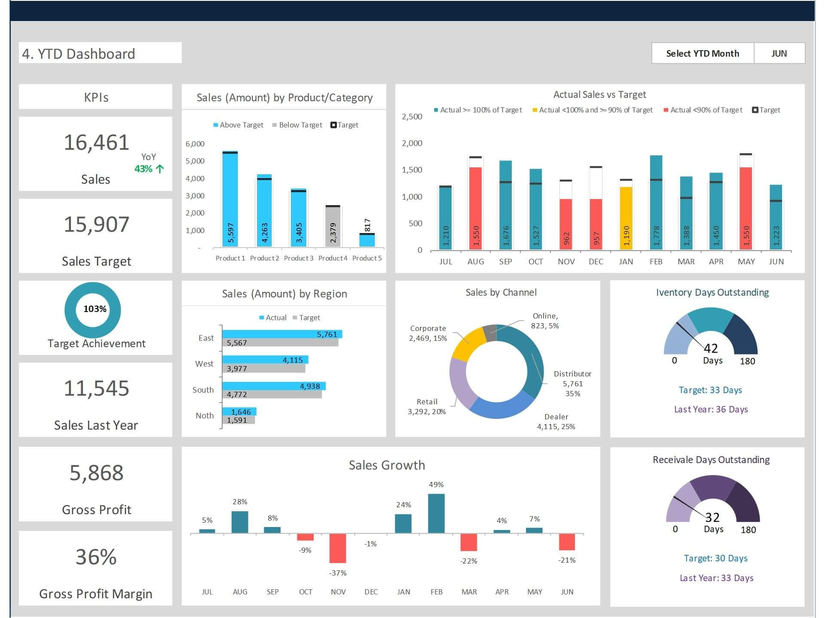
Dashboard Interactivity Features
Interactive slicers and filters allow users to customize their view of the data.
Drill-through capabilities enable deeper analysis of specific metrics and trends.
Users can easily switch between different time periods or scenarios for comparison.
Notes:
Image source: https://i.pinimg.com

Slide 14

Collaboration and Sharing Insights
Power BI dashboards can be shared with stakeholders for collaborative decision-making.
Users can publish reports to the Power BI service for broader accessibility.
Commenting features facilitate discussions around specific data points within the dashboard.
Notes:
Image source: https://www.designandexecute.com

Slide 15
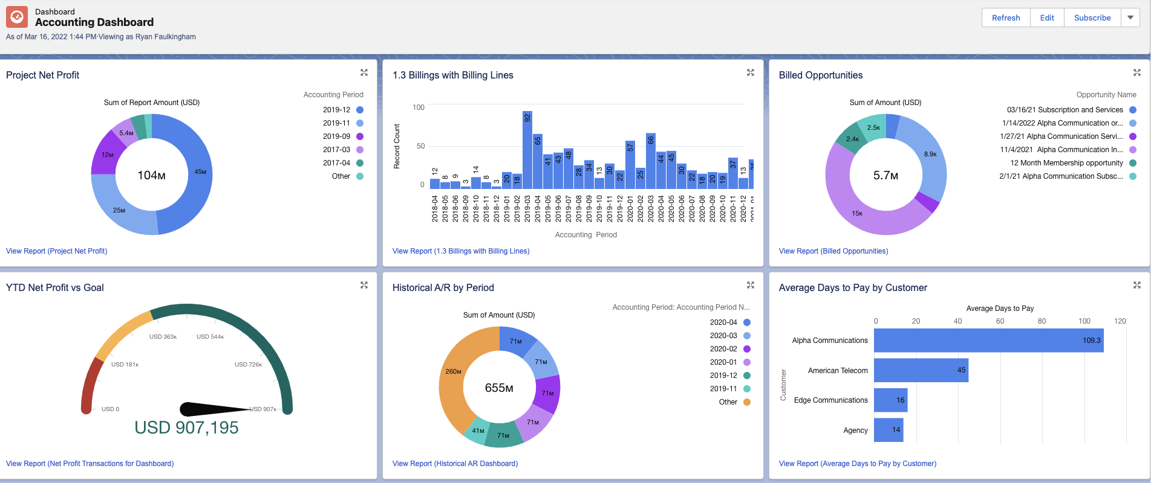
Best Practices for Designing Financial Dashboards
Keep the dashboard layout clean and intuitive to enhance user experience.
Prioritize the most critical metrics to avoid information overload.
Regularly update the dashboard to reflect the most current financial data.
Notes:
Image source: https://www.accountingseed.com

Slide 16
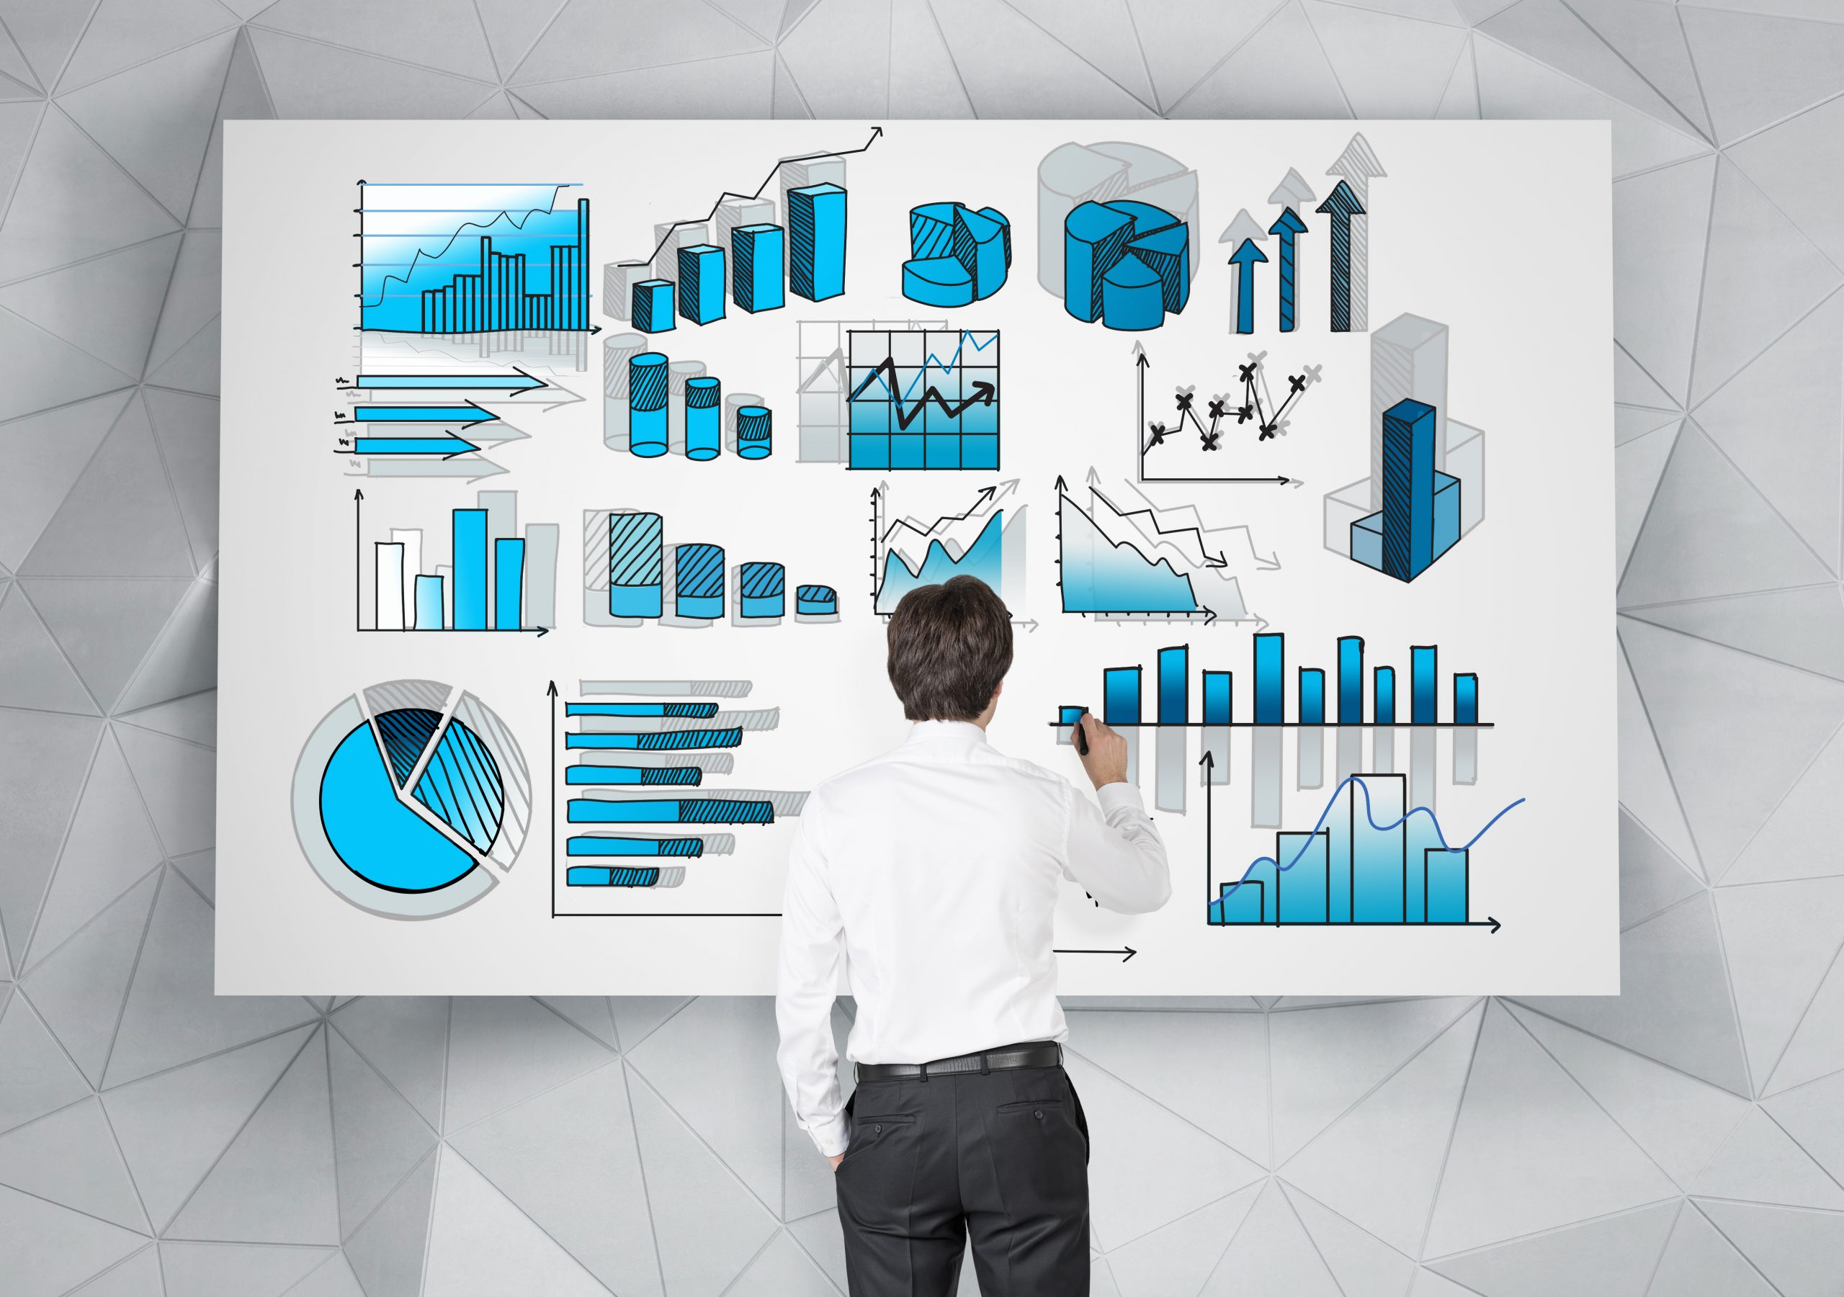
Challenges in Financial Forecasting
Data accuracy and consistency can pose significant challenges in forecasting.
Economic volatility can impact the reliability of financial predictions.
Ensuring stakeholder buy-in for forecasting assumptions may require effective communication.
Notes:
Image source: https://innovecs.com

Slide 17

Case Study: Successful Implementation
A leading company utilized Power BI to streamline its financial forecasting process.
The dashboard improved visibility into key financial metrics and facilitated faster decision-making.
Stakeholder engagement increased significantly due to enhanced data accessibility.
Notes:
Image source: https://www.netsuite.com

Slide 18

Future Trends in Financial Forecasting
AI and machine learning are expected to play a larger role in financial forecasting.
Real-time data analytics will become increasingly vital for timely decision-making.
Enhanced visualization techniques will improve stakeholder engagement and understanding.
Notes:
Image source: https://jelvix.com

Slide 19
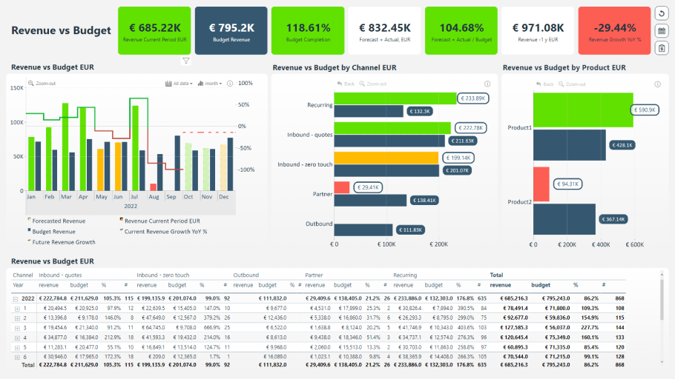
Conclusion
Power BI is a powerful tool for creating effective financial forecasting dashboards.
By leveraging its features, organizations can enhance their financial planning processes.
A well-designed dashboard enables data-driven decision-making, contributing to overall business success.
This presentation provides a comprehensive overview of financial forecasting using Power BI, highlighting its importance, functionality, and best practices.
Notes:
Image source: https://zoomchartswebstorage.blob.core.windows.net

